Slide 1
Chapter 3
Regular Expressions

Slide 2
Simplifying Regular Expression
Union && Regular Expression as a set
Union is commutative
α ∪ β = β ∪ α
Union is associative
(α ∪ β) ∪ Υ = α ∪ (β ∪ Υ)
∅ Is identity for union
α ∪ ∅ = ∅ ∪ α = α
union is idempotent
α ∪ α = α

Slide 3
Simplifying Regular Expression
Concatenation && Regular Expression
Concatenation is associative
(αβ)Υ = α(βΥ)
ε is identity for Concatenation
αε = εα = α
∅ is a zero for concatenation
∅α = α∅ = ∅
Concatenation is distributed over union
(α ∪ β) Υ = (αΥ) ∪ (βΥ )
Υ(α ∪ β) = (Υα) ∪ (Υβ )

Slide 4
Simplifying Regular Expression
Kleen Star
∅* = ε
ε* = ε
(α * ) * = α *
α * α * = α *
(α ∪ β) * = (α * β* ) *

Slide 5
Simplifying Regular Expression
Given two set A & B if A⊆ B then A∪ B = B
a* ∪ aa = a* , since L(aa) ⊆ L(a* )
For any regular expression α and β , if L(α * ) ⊆ L(β * ) then α * β ^{* =} β *
a* ∪ (a ∪ b ) * = (a ∪ b ) * , since L(a*) ⊆ L((a ∪ b) * )
If L(β * ) ⊆ L(α *) then α * β ^{* =} α*
If L(β ) ⊆ L(α *) then (α ∪β) ^{* =} α *
(a ∪ ε ) * = a* since ε ⊆ a*
(a ∪ aa ) * = a* since aa ⊆ a*

Slide 6
Example Simplifying Regular Expression
Simplify the following Regular expression
((a* ∪ ∅) * ∪ aa )(b ∪ bb )* b * ((a ∪ b ) * b * ∪ ab ) *
Solution
((a* ∪ ∅) * ∪ aa )(b ∪ bb )* b * ((a ∪ b ) * b * ∪ ab ) * ∅ is identity for union
((a*) * ∪ aa )(b ∪ bb )* b * ((a ∪ b ) * b * ∪ ab ) * (a*) * = a*
(a* ∪ aa )(b ∪ bb )* b * ((a ∪ b ) * b * ∪ ab ) * aa⊆a*
a* (b ∪ bb )* b * ((a ∪ b ) * b * ∪ ab ) * (α∪β)* =(α*β* ) *
a* (b*(bb)*)* b * ((a ∪ b ) * b * ∪ ab ) * (bb) *⊆b*
a* (b*)* b * ((a ∪ b ) * b * ∪ ab ) * (b *) ^{* =} b*

Slide 7
Example Simplifying Regular Expression
a* (b*)* b * ((a ∪ b ) * b * ∪ ab ) * (b *) ^{* =} b*
a* b* b * ((a ∪ b ) * b * ∪ ab ) * b * b* =b*
a* b* ((a ∪ b )* b * ∪ ab ) * b* ⊆ (a∪b) *
a* b* ((a ∪ b ) * ∪ ab ) * ab ⊆ (a∪b)*
a* b* ((a ∪ b ) *)* ((a∪b) *) * =(a∪b) *
a* b* (a ∪ b )* b* ⊆ (a∪b) *
a* (a ∪ b )* a* ⊆ (a∪b) *
(a ∪ b )*
((a* ∪ ∅) * ∪ aa )(b ∪ bb )* b * ((a ∪ b ) * b * ∪ ab ) * = (a ∪ b )*

Slide 8
Finite Automata (FA) & R.E.
To show that they are interchangeable FA and R.E., consider the following theorems:
Theorem 1: For every DFA A there exists a regular expression R such that L(R)=L(A)
Theorem 2: For every regular expression R there exists an ε-NFA E such that L(E)=L(R)

Slide 9
Finite Automata (FA) & Reg Ex
Kleene Theorem
ε -NFA
NFA
Theorem 2
R.E.
DFA
Theorem 1

Slide 10
Constructing R.E. From a DFA
DFA
Theorem 1
R.E.
Informally, trace all distinct paths (traversing cycles only once) from the start state to each of the final states and enumerate all the expressions along the way.
However the paths are allowed to pass through only limited number of states.
0
0,1
start
q₀
1
q₁

Slide 11
Constructing R.E. From a DFA
Builds a R.E. that describe set of string that label a certain paths in the DFA.
Paths are allowed to pass through only limited number of States.
Basic : not allowed to pass through any state
Inductive : path pass through larger set.
Allowed to pass any state (i.e., represent all possible path)

Slide 12
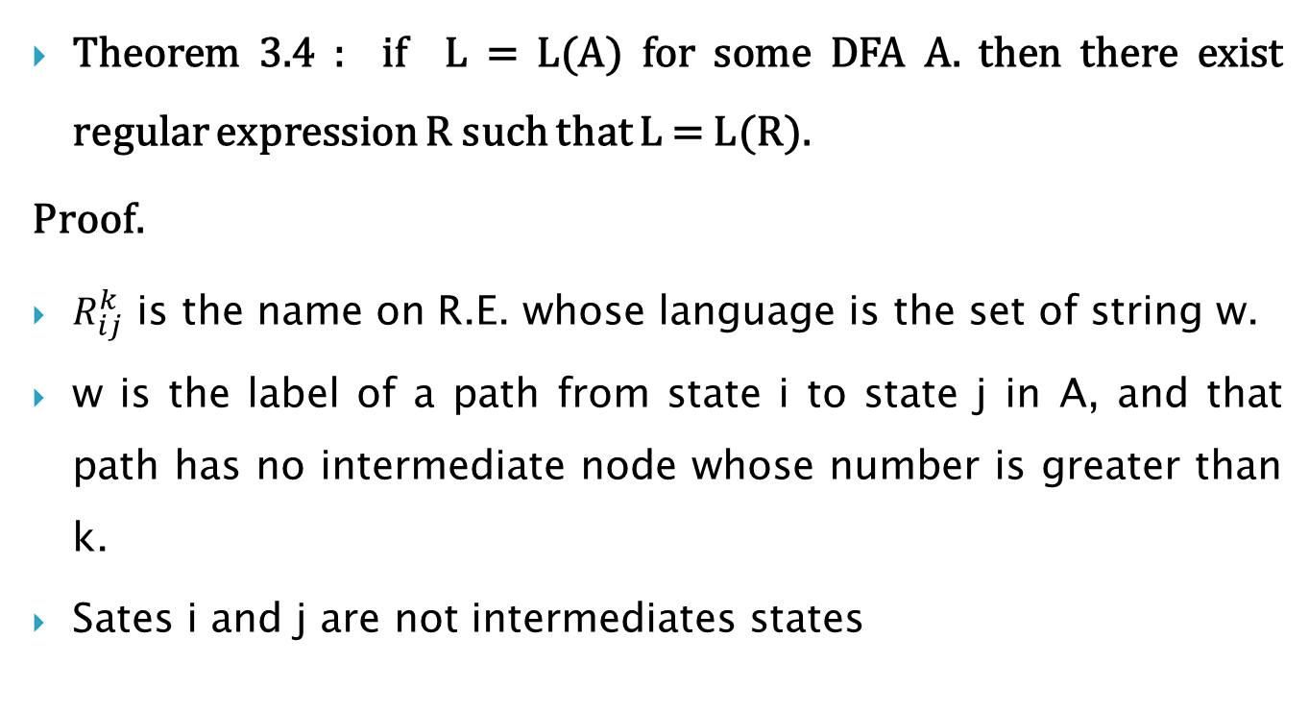
Constructing R.E. From a DFA
Theorem 3.4 : if L = L(A) for some DFA A. then there exist regular expression R such that L = L(R).
Proof.
$R_{ij}^{k}$ is the name on R.E. whose language is the set of string w.
w is the label of a path from state i to state j in A, and that path has no intermediate node whose number is greater than k.
Sates i and j are not intermediates states
0
0,1
start
q₀
1
q₁
1
q₂
0

Slide 13
Constructing R.E. From a DFA
A path whose label is in language of regular expression $R_{ij}^{k}$

Slide 14
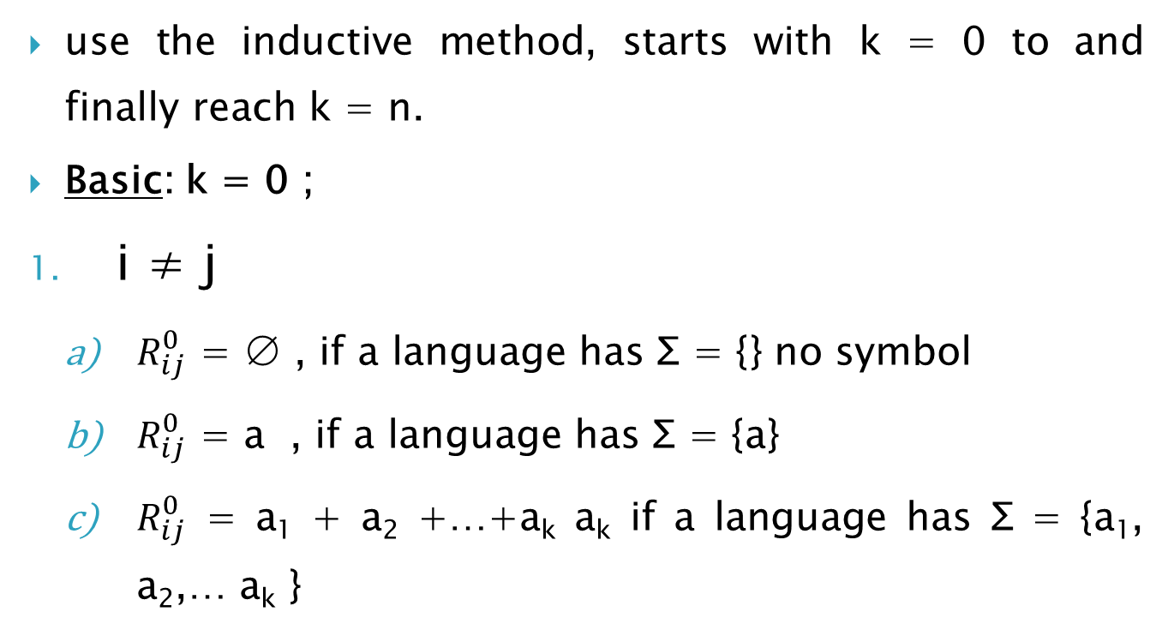
Constructing R.E. From a DFA
use the inductive method, starts with k = 0 to and finally reach k = n.
Basic: k = 0 ;
i ≠ j
$R_{ij}^{0}$ = ∅ , if a language has Σ = {} no symbol
$R_{ij}^{0}$ = a , if a language has Σ = {a}
$R_{ij}^{0}$ = a₁ + a₂ +…+a_{k} a_{k} if a language has Σ = {a₁, a₂,… a_{k} }
a
a,b
start
1
b
2
b
3
Σ
a
i
j

Slide 15
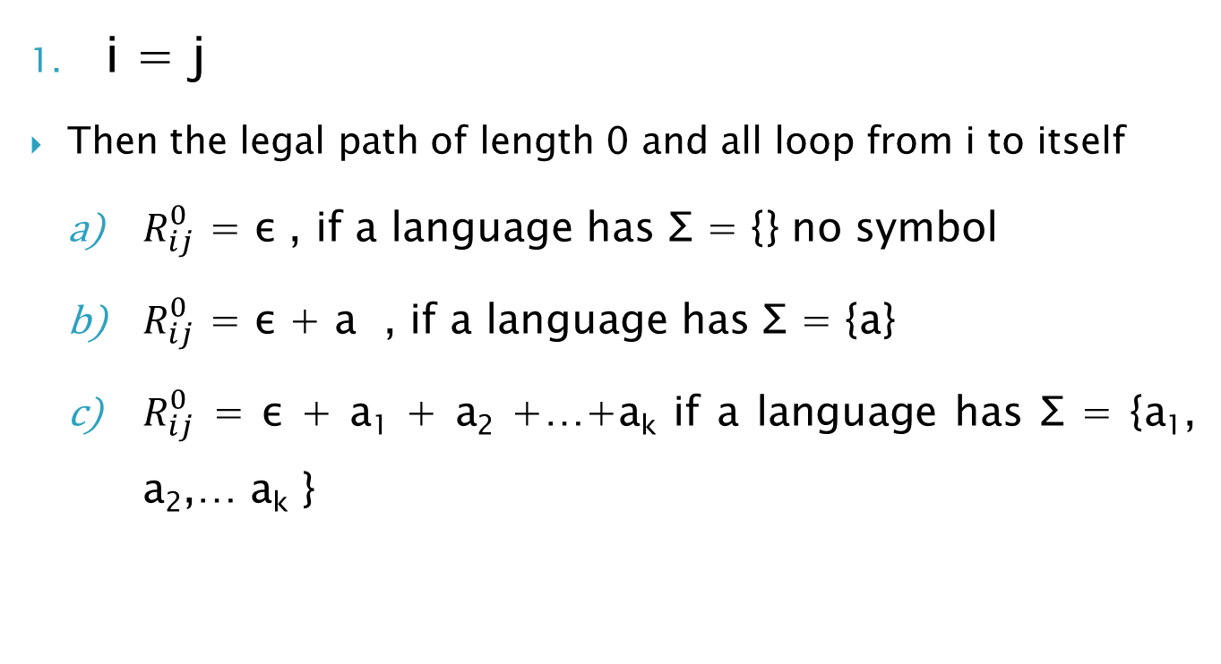
Constructing R.E. From a DFA
Σ
i = j
Then the legal path of length 0 and all loop from i to itself
$R_{ij}^{0}$ = ε , if a language has Σ = {} no symbol
$R_{ij}^{0}$ = ε + a , if a language has Σ = {a}
$R_{ij}^{0}$ = ε + a₁ + a₂ +…+a_{k} if a language has Σ = {a₁, a₂,… a_{k} }
I = j
a
a,b
start
1
b
2
b
3
a

Slide 16
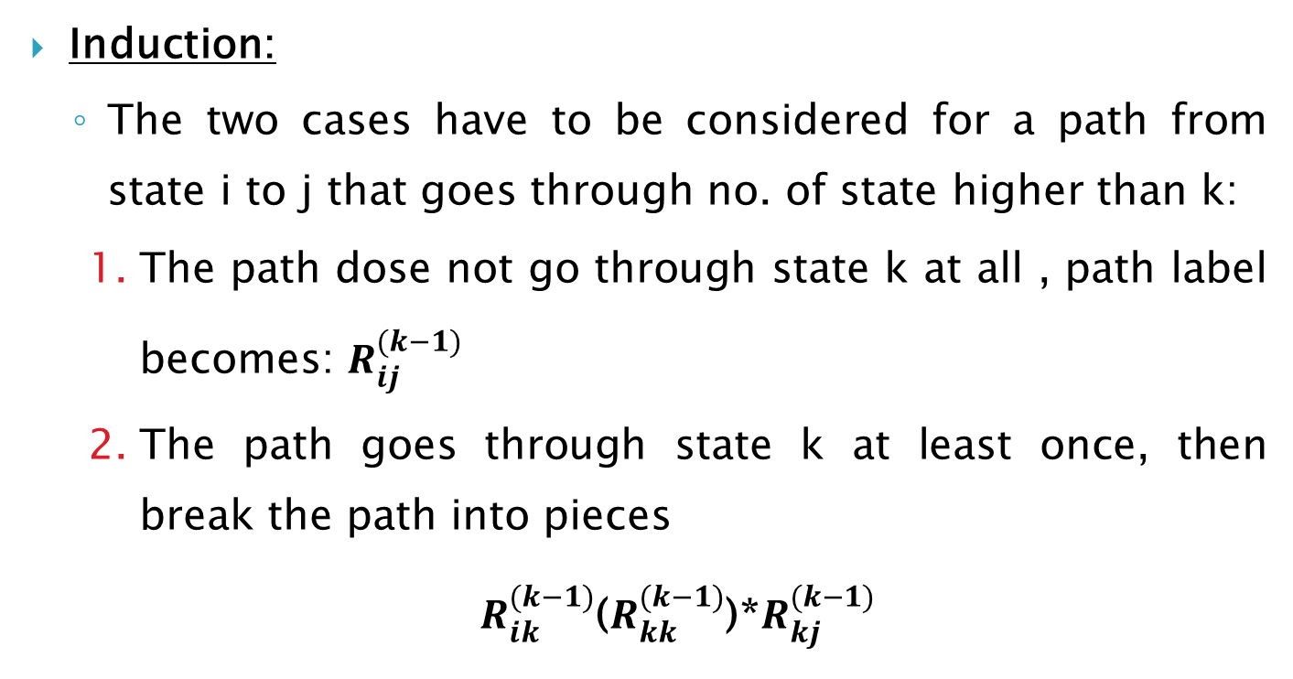
Constructing R.E. From a DFA
Induction:
The two cases have to be considered for a path from state i to j that goes through no. of state higher than k:
The path dose not go through state k at all , path label becomes: $R_{ij}^{(k−1)}$
The path goes through state k at least once, then break the path into pieces
$R_{ik}^{(k−1)}$($R_{kk}^{(k−1)}$)*$R_{kj}^{(k−1)}$

Slide 17

Constructing R.E. From a DFA
Combine both :
$R_{ij}^{(k)}$ = $R_{ij}^{(k−1)}$+ $R_{ik}^{(k−1)}$($R_{kk}^{(k−1)}$)*$R_{kj}^{(k−1)}$
Assume state 1 is the start state, then the regular expression is the union of all expression
$R_{1j}^{(n)}$ such that j is an accepting state

Slide 18





Constructing R.E. From a DFA
Example: convert the following DFA into a R.E.
1
0,1
start
1
0
2
$$R_{ij}^{(0)}$$
$$R_{11}^{(0)}$$
∊ + 1
$$R_{12}^{(0)}$$
0
$$R_{21}^{(0)}$$
∅
$$R_{22}^{(0)}$$
∊ +0+ 1

Slide 19











Constructing R.E. From a DFA
$R_{ij}^{(k)}$ = $R_{ij}^{(k−1)}$+ $R_{ik}^{(k−1)}$($R_{kk}^{(k−1)}$)*$R_{kj}^{(k−1)}$
$$R_{ij}^{(0)}$$
$R_{ij}^{(1)}$ = $R_{ij}^{(0)}$+ $R_{i1}^{(0)}$($R_{11}^{(0)}$)*$R_{1j}^{(0)}$
$$R_{11}^{(0)}$$
∊ + 1
By direct substitution Simplified
$$R_{12}^{(0)}$$
0
$$R_{21}^{(0)}$$
∅
$$R_{11}^{(1)}$$
∊ + 1 +(∊ + 1)(∊ + 1)*(∊ + 1)
$$R_{22}^{(0)}$$
∊ +0+ 1
$$R_{12}^{(1)}$$
0+(∊ + 1)(∊ + 1)*0
$$R_{21}^{(1)}$$
∅ +∅(∊ + 1)*(∊ + 1)
$$R_{22}^{(1)}$$
∊ +0+1+ ∅(∊ + 1)*0

Slide 20
Constructing R.E. From a DFA
∊ + 1 +(∊ + 1)(∊ + 1)*(∊ + 1) ( + ∊1 ) ⊆ (+ ∊1) *
∊ + 1 +(∊ + 1)*(∊ + 1) ( + ∊1 ) ⊆ (+ ∊1) *
∊ + 1 +(∊ + 1)* ( + ∊1 ) ⊆ (+ ∊1) *
(∊ + 1)* (+ ∊ 1) * = (∊*1*)
(∊*1*) ∊* = ∊
∊1* ∊1* = 1*
1*
$$R_{ij}^{(0)}$$
By direct substitution Simplified
$$R_{11}^{(1)}$$
∊ + 1 +(∊ + 1)(∊ + 1)*(∊ + 1)
$$R_{12}^{(1)}$$
0+(∊ + 1)(∊ + 1)*0
$$R_{21}^{(1)}$$
∅ +∅(∊ + 1)*(∊ + 1)
$$R_{22}^{(1)}$$
∊ +0+1+ ∅(∊ + 1)*0

Slide 21
Constructing R.E. From a DFA
By direct substitution Simplified
$$R_{11}^{(1)}$$
∊ + 1 +(∊ + 1)(∊ + 1)*(∊ + 1)
1*
$$R_{12}^{(1)}$$
0+(∊ + 1)(∊ + 1)*0
1* 0
$$R_{21}^{(1)}$$
∅ +∅(∊ + 1)*(∊ + 1)
∅
$$R_{22}^{(1)}$$
∊ +0+1+ ∅(∊ + 1)*0
∊ + 0 + 1

Slide 22










Constructing R.E. From a DFA
$R_{ij}^{(k)}$ = $R_{ij}^{(k−1)}$+ $R_{ik}^{(k−1)}$($R_{kk}^{(k−1)}$)*$R_{kj}^{(k−1)}$
$$R_{ij}^{(1)}$$
$R_{ij}^{(2)}$ = $R_{ij}^{(1)}$+ $R_{i2}^{(1)}$($R_{22}^{(1)}$)*$R_{2j}^{(1)}$
$$R_{11}^{(1)}$$
1*
$$R_{12}^{(1)}$$
1* 0
By direct substitution Simplified
$$R_{21}^{(1)}$$
∅
$$R_{22}^{(1)}$$
∊ + 0 + 1
$$R_{11}^{(2)}$$
1*+1*0(∊+0+1)* ∅
1*
$$R_{12}^{(2)}$$
1*0+1*0(∊+0+1)*(∊+0+1)
1* 0(0+1)*
$$R_{21}^{(2)}$$
+ ∅(∊+0+1)(∊+0+1)*∅
∅
$$R_{22}^{(2)}$$
∊+0+1+(∊+0+1)(∊+0+1)*(∊+0+1)
(0+1)*

Slide 23
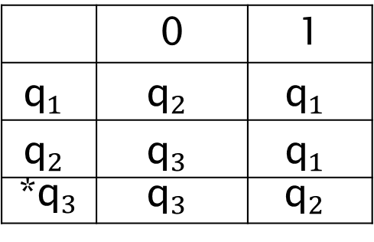
Exercise1
Given the following transition table, By construction methods, builds a R.E. Describe the same language.
1 | 0
$${\text{q}}_{1}$$ | $${\text{q}}_{2}$$ | $${\text{q}}_{1}$$
$${\text{q}}_{1}$$ | $${\text{q}}_{3}$$ | $${\text{q}}_{2}$$
$${\text{q}}_{2}$$ | $${\text{q}}_{3}$$ | *${\text{q}}_{3}$

Slide 24
Convert DFA to R.E by state elimination

Slide 25
Convert DFA to R.E by state elimination

Slide 26
Convert DFA to R.E by state elimination

Slide 27
Convert DFA to R.E by state elimination
Convert the following FA to R.E.
a
e
b
start
1
2
3
d
c
To eliminate State number 2 four paths have be substituted
Path from state 1 to state 1 through state 2
Path from state 3 to state 3 through state 2
Path from state 1 to state 3 through state 2
Path from state 3 to state 1 through state 2

Slide 28
Convert DFA to R.E by state elimination
Path from state 1 to state 1 through state 2
a
e
b
start
1
2
3
d
c
ae*d
start
1
3

Slide 29
Convert DFA to R.E by state elimination
Path from state 3 to state 3 through state 2
a
e
b
start
1
2
3
d
c
ae*d
ce*b
start
1
3

Slide 30
Convert DFA to R.E by state elimination
Path from state 1 to state 3 through state 2
a
e
b
start
1
2
3
d
c
ae*d
ae*b
ce*b
start
1
3

Slide 31
Convert DFA to R.E by state elimination
Path from state 3 to state 1 through state 2
a
e
b
start
1
2
3
d
c
ae*d
ae*b
ce*b
start
1
3
ce*d

Slide 32
Convert DFA to R.E by state elimination
Example 1 : Convert the following FA to R.E.
2
a
a
b
b
start
1
b
3
a

Slide 33
Convert DFA to R.E by state elimination
ab
aa
start
1
b + aa
3
a + bb

Slide 34
Convert DFA to R.E by state elimination
ab
start
1
(b + aa)(aa)*(a + bb)

Slide 35
Convert DFA to R.E by state elimination
∊ + ab + (b + aa)(aa)*(a + bb)
start
1
R.E = (ab+(b+aa)(ba)*(a+bb))*

Slide 36
Convert DFA to R.E by state elimination
Automaton with R.E. labels

Slide 37
Convert DFA to R.E by state elimination
Eliminating state B

Slide 38
DFA to Reg Ex by eliminating states

Slide 39
Exercise 2
Convert the following DFA to R.E. using the state elimination technique
1 | 0
p | s | P*
s | p | q
q | r | r
r | q | s

Slide 40



Example 2
Convert the following DFA to R.E. using the state elimination technique
b
a
b | a
q₀ | q₁ | q₀*
q₀ | q₂ | q₁
q₀ | q₂ | q₂
$$q_{0}$$
$$q_{1}$$
b
a
b
$$q_{2}$$
a

Slide 41

Example 2
Step 1 :
If the start state is an accepting state or has transitions in, add a new non-accepting start state and add an ∊-transition between the new start state and the former start state.
b
a
s
∊
$$q_{0}$$
$$q_{1}$$
∊
b
a
f
b
$$q_{2}$$
a

Slide 42
Example 2
Step 2 :
If there is more than one accepting state or if the single accepting state has transitions out, add a new accepting state, make all other states non-accepting, and add an ∊-transition from each former accepting state to the new accepting state.
b
a
s
∊
$$q_{0}$$
$$q_{1}$$
∊
b
a
f
b
$$q_{2}$$
a

Slide 43

Example 2
Step 3 :
For each non-start non-accepting state in turn, eliminate the state and update transitions according
Eliminate q₂
b
a
s
∊
$$q_{0}$$
$$q_{1}$$
b + aa*b
∊
f

Slide 44

Example 2
Step 3 :
Eliminate q₁
b + a(b + aa*b)
s
∊
$$q_{0}$$
∊
f

Slide 45
Example 2
Step 3 :
Eliminate q₀
s
(∊+ b + a(b + aa*b))*
f

Slide 46
Example 2
Step 3 :
Eliminate q₀
s
(b + a(b + aa*b))*
f

Slide 47
Exercise 3
Convert the following FA to R.E. using the state elimination technique
b
b
b
a
start
1
2
∊
3
4
a
a
a

